Slide 1

2C4I
An Agile Inception Deck
Jaideep Singh N8986746
Wenbo Shi N9327738
Hing Lim Jee N9238557
Zejin Du N9327614
Yuchen Zhao N9327762
Yingjie Jiang N9327690
2C4I

Slide 2
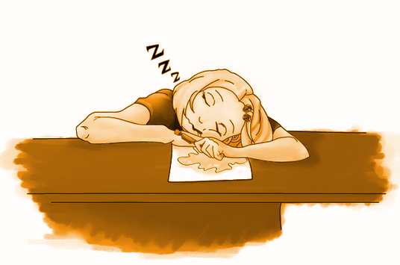

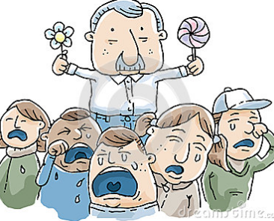

Why Are We Here?
#1
TO HELP FOREIGNERS SOLVE ISSUES
SLOW
#2 TO IMPROVE HELPDESK WORKING EFFICIENCY
QUICK
#3
TO HELP VOLUNTEERS WORKING BETTER
2C4I

Slide 3
Elevator Pitch
Hello Brisbane helpdesk,
We know that your volunteers working efficient is low, but we also know that they working carefully!
Team 2C4I thinks that we can bring these two great things together in our
system, 'Brisbane Helpdesk'.
Unlike the current model, our product will help your staff working at any time and any place!
Using smart tracking software, our system will monitor the progress and help improving working effective and efficient.
Our game will lead your staffs and clients to a brighter, smarter and most importantly, more efficiently future.
2C4I

Slide 4
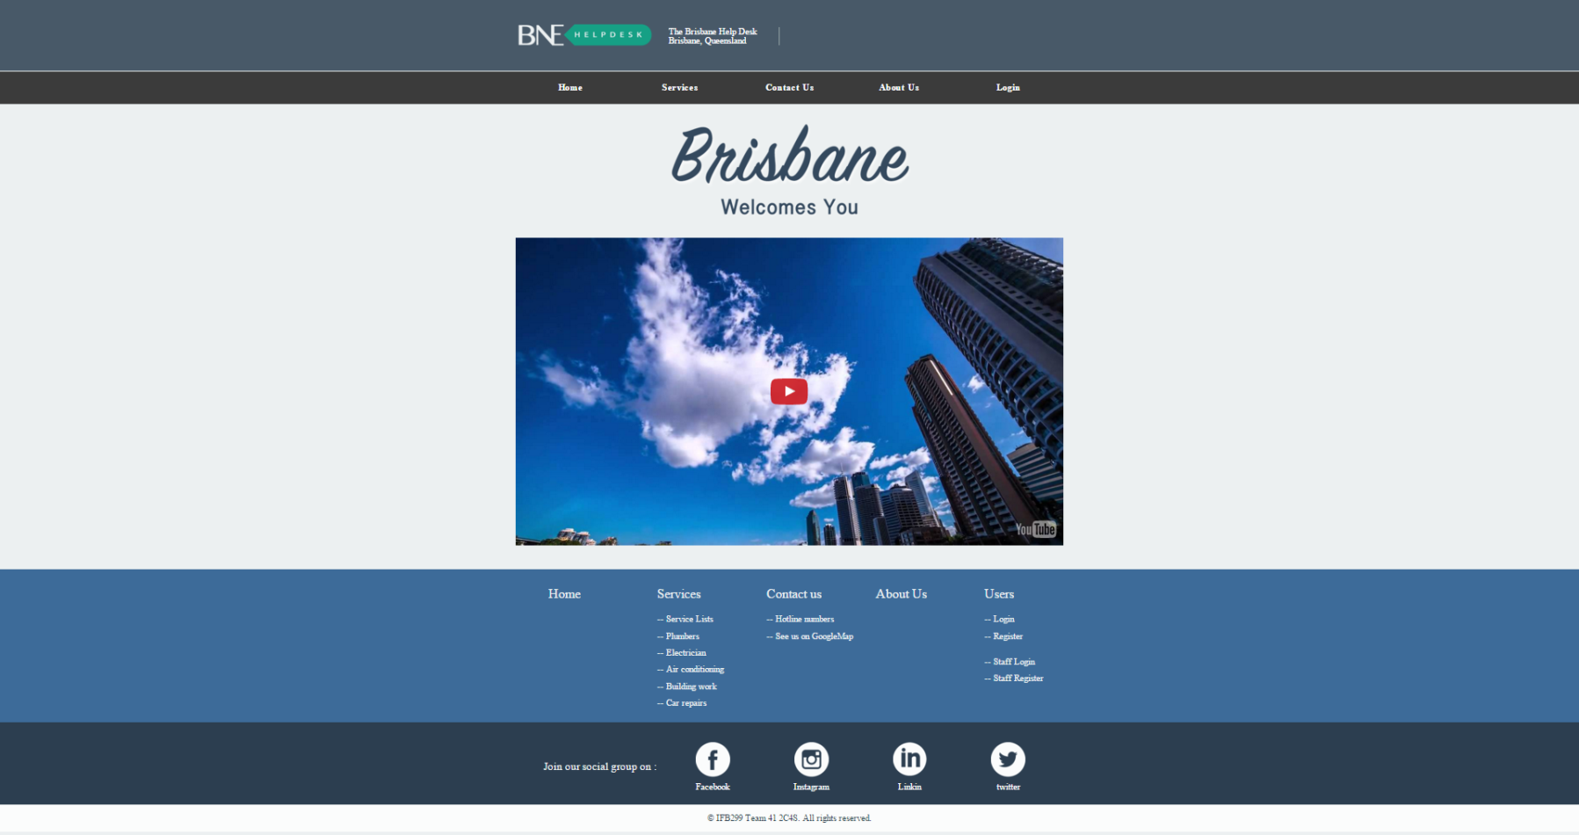
Product Box
Product Box
2C4I

Slide 5
The NOT List
In Scope:
Functional system
Questions and challenges for each class
Start tracking
Volunteer control over the system
Reward system
Login server
Cross platform compatibility
Not in Scope:
Online chat
Smartphone integration
Console release
Randomly generated dungeons
Level editor
Micro transactions
Unresolved:
Co-op using
Mark system
Language function
2C4I

Slide 6











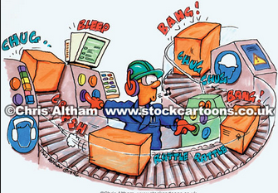
Meet the Neighbours
Sources of funding! The department of Brisbane helpdesk.
Our Core team: IT experts!
Target Audience and testers: Users (Foreigners who need help)
Helpdesk volunteers
People we need to sell our System: Helpdesk, Corporate company
Non-Technical expertise:
Artists, animators and voice actors
2C4I

Slide 7




Show the Solution
[2],[3]
[2],[3]
Languages---
C# [2],SQL[3]
[2],[3]
[1],[3]
Jira [4]---
Tracking their progress
Database [1] ---
Storing the
information
Technical architecture
Github [5]---
Viewing everyone’s work
[2],[3],[4],[5]
2C4I

Slide 8

What keeps us up at night?
TEACHING Lessons
GIVING QUALITY CONTENT
Not having in house animators
Making a SYSTEM that can appeal to a majority of users
Preventing Users and volunteers exploiting bugs
Advertising
Having a small team
Ensuring the STSTEM works on ALL COMPUTERs
Convincing local governments to support our idea
2C4I

Slide 9
Size it up
$125k - $150k
2-3 months
2-3 Months
2-3 months
Development
$18k - $22k
Market Research
Hiring
Design Infrastructure
Sprint Cycle
Prioritize Requirements
Testing & Improvement
$3k-$5k
1-2 months
$10k-$12k
Review
Market Research: Basic market Research, Surveys, trends in our target audience - $3000-$4500
Hiring: Developers, Testers
Salesmen - $18000-$22000 (Cost of Recruitment)
Design Infrastructure: $10000-$12000
Testing and Improvement: Debugging, Retouching and Retesting - $5000-$7000 Per Sprint
Deployment
2C4I

Slide 10
What’s going to give: The Priority Pyramid
Stability
Budget
Security
Easy of Use
Effect on learning
Quality
Completion Time
Lower
Higher
System using
Flexibility
Importance
Account database
Higher
Lower
Art
Friend system
Scope
2C4I

Slide 11
What’s it going to take?
MoW 1.0 (First Release)
Release 1 (7-8 Weeks, $210k-$250k ) | Release 2 (3-4 Weeks, $130k-150k) | Release 3 (2-3Weeks, $80k-$100k) | Release 4 (2-3 Weeks , $80k-$100k)
Simple system(M) Database at back-end (M) Login server(M) Compatible with Windows AND Mac OS (S) Rudimentary Graphics (M) | Simple system(M) Database at back-end (M) Login server(M) Compatible with Windows AND Mac OS (S) Rudimentary Graphics (M) | Let users feedback to us(C) Let the volunteers provide feedback (S) Improve our system(S) | Simplification of UI for easy understanding (S) Automated testing (M) Let users feedback to us(C) Let the volunteers provide feedback (S) Improve our system(S)
Estimated Cost of First Release: $500k - $600k
Estimated Manpower: 20
Estimated Release Time: 15-18 Months
2C4I

